Slide 1


Introduction to DevOps
By Ms. Megha Ughade
Class-SYMCA Sem-III

Slide 2
What is DevOps?
DevOps is a combination of two words: Development (Dev) and Operations (Ops). It is a modern software development approach in which developers and operations engineers work together throughout the entire software development process. Instead of working as separate teams, they collaborate continuously to build, test, deploy, and maintain software efficiently.
DevOps is not just a tool or technology; it is a culture, a mindset, and a set of practices that encourages communication, collaboration, automation, and continuous improvement. Its main goal is to deliver high-quality software to users faster and with fewer errors.
In traditional software development, developers focused only on writing code, while operations teams were responsible for deploying and maintaining the application. Because these teams worked separately, communication problems often occurred, leading to delays, deployment failures, and customer dissatisfaction. DevOps solves these problems by encouraging both teams to work together from the beginning of the project.

Slide 3
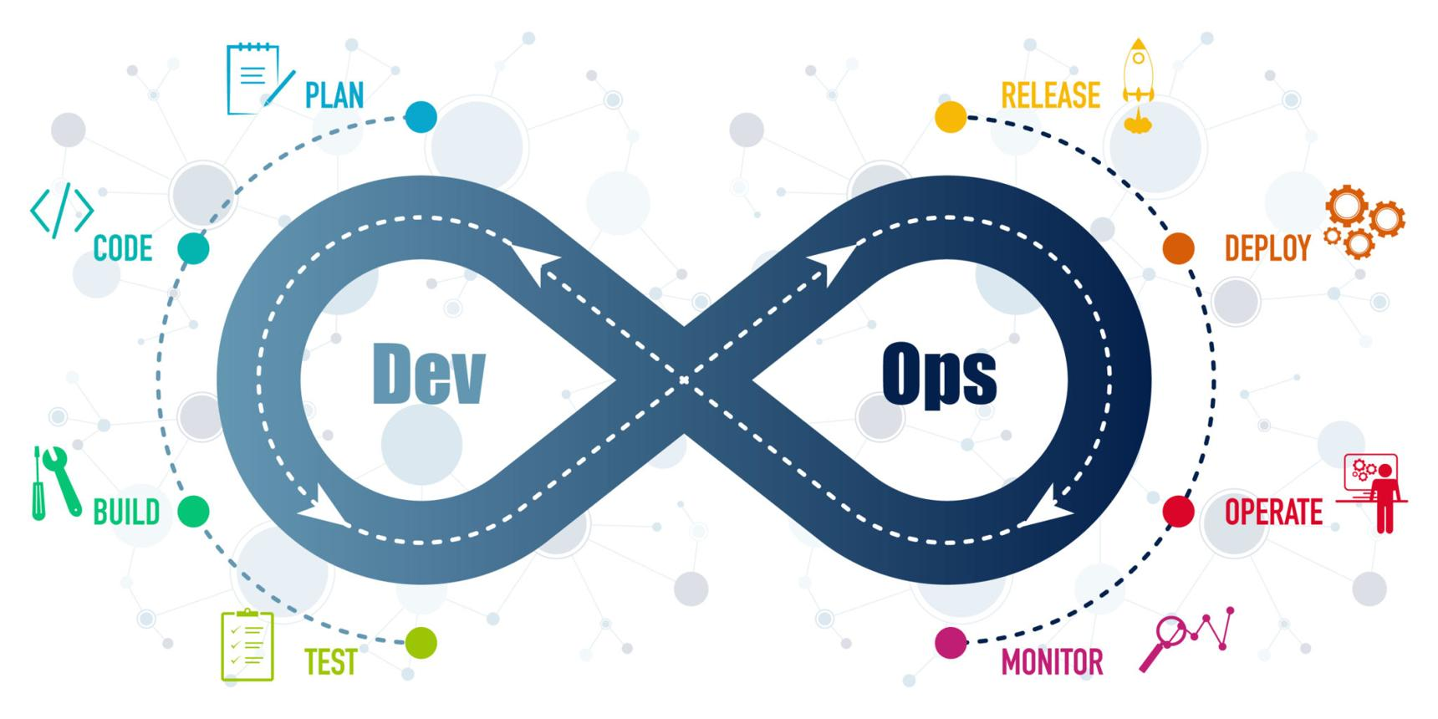

Real-Life Example
Imagine a restaurant.
The chef prepares the food.
The delivery person delivers it to the customer.
If the chef and delivery person do not communicate properly, the food may be delivered late or become cold. However, if they coordinate effectively, customers receive fresh food on time.
Similarly, in DevOps:
Developers create the software.
Operations teams deploy and maintain it.
By working together, software reaches customers quickly and reliably.

Slide 4
Why Do We Need DevOps?
As software applications became larger and more complex, organizations realized that traditional development methods could not meet customer expectations. Customers now expect new features, security updates, and bug fixes quickly. Delivering software every few months is no longer acceptable in today's fast-changing digital world.
Before DevOps, development and operations teams worked independently. Developers completed coding and then handed the software over to the operations team for deployment. If deployment failed, both teams often blamed each other instead of solving the problem together. This caused delays, increased costs, and frustrated customers.
DevOps was introduced to eliminate these communication gaps. It encourages continuous collaboration and uses automation to reduce manual work, making software delivery faster and more reliable.

Slide 5
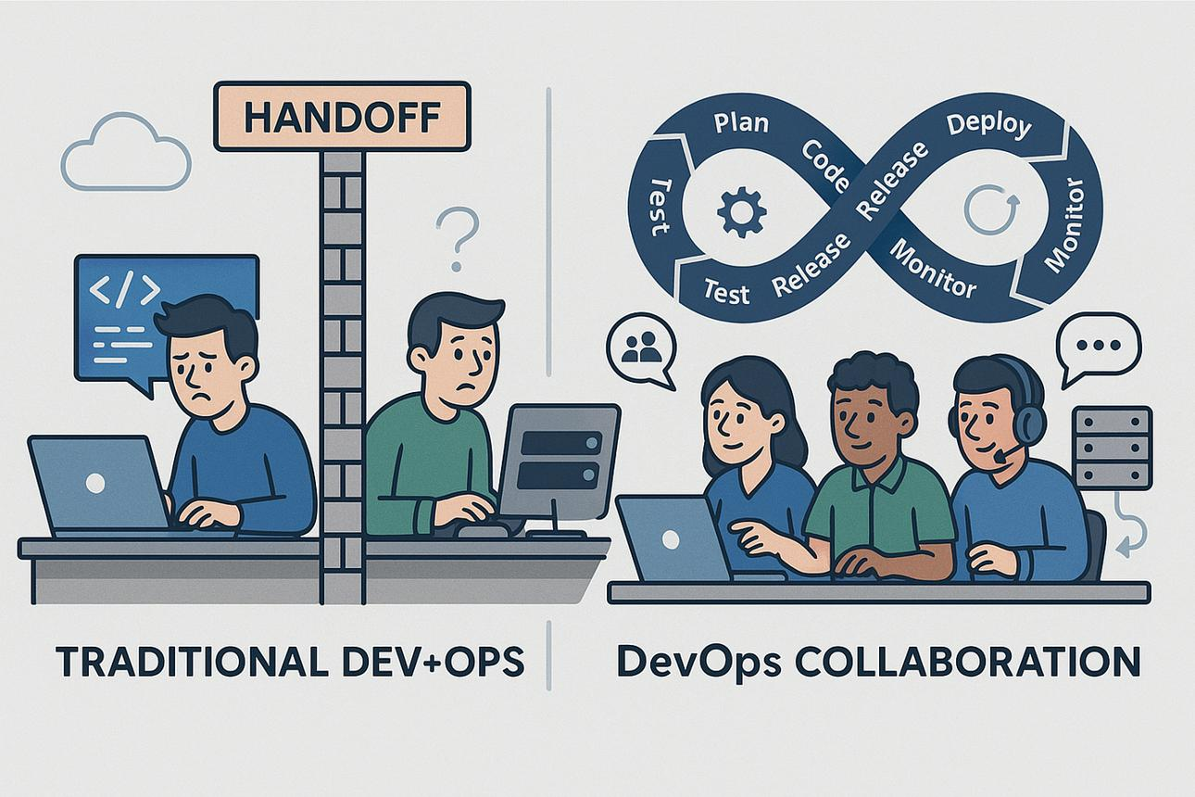
Problems Before DevOps
Development and Operations teams worked separately.
Software deployment took a long time.
Testing was mostly manual, making it slow and error-prone.
Bugs were often discovered only after deployment.
Customers had to wait a long time for updates.
  Advantages After Adopting DevOps
Faster software releases.
Better communication between teams.
Automated testing and deployment.
Improved software quality.
Reduced downtime.
Faster bug fixing.
Increased customer satisfaction.
Notes:
Real-Life Example
Consider an online shopping website such as Amazon.
Customers expect new offers, discounts, and payment features regularly. If updates take several months, competitors may attract those customers. DevOps enables companies to release improvements quickly without affecting existing users.

Slide 6
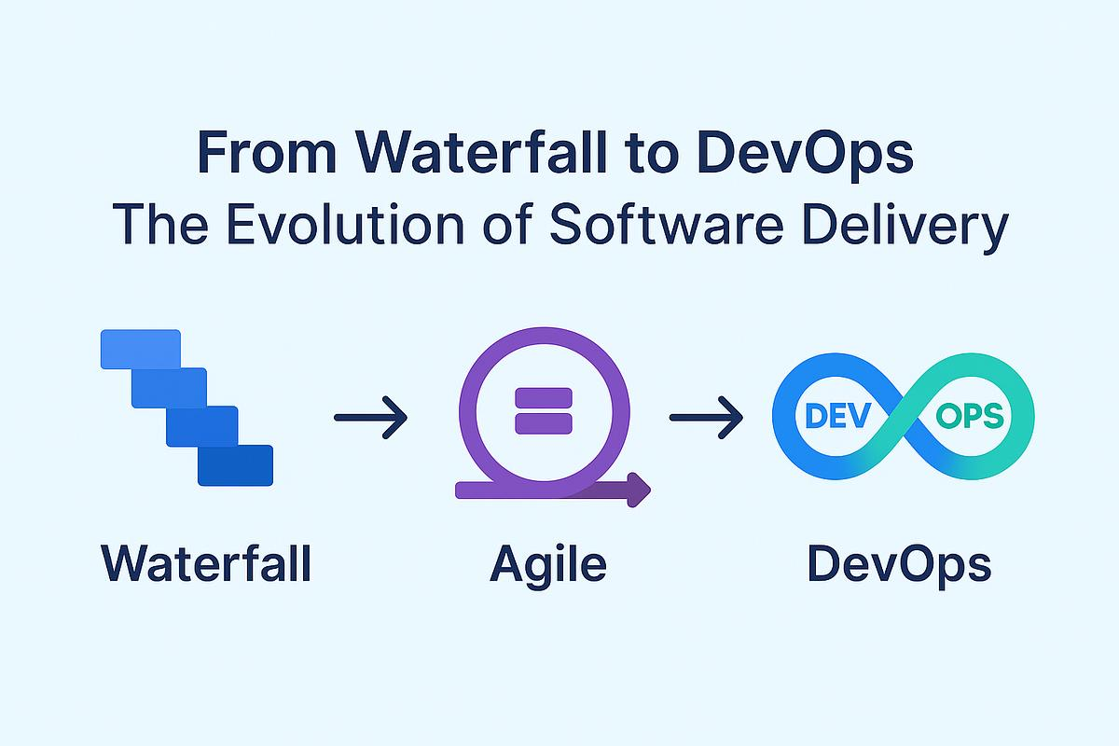
Evolution of Software Development
Evolution: Waterfall → Agile → DevOps
Software development has evolved over time to meet changing business requirements and customer expectations.
1. Waterfall Model
The Waterfall model is the oldest software development methodology. In this model, each phase is completed before moving to the next phase.
The sequence is:
Requirements → Design → Development → Testing → Deployment → Maintenance
Once a phase is completed, it is difficult to go back and make changes.
Advantages
Easy to understand.
Well-organized documentation.
Suitable for small projects with fixed requirements.
Disadvantages
Very slow.
Changes are difficult after development begins.
Errors discovered late become expensive to fix.
Customers see the final product only after completion.

Slide 7
2. Agile Methodology
Agile was introduced to overcome the limitations of the Waterfall model.
Instead of developing the entire project at once, Agile divides the project into small parts called Sprints. Each sprint usually lasts between one and four weeks.
At the end of every sprint, customers review the software and provide feedback. Developers then improve the product based on this feedback.
Advantages
Faster development.
Continuous customer involvement.
Easy to make changes.
Early bug detection.
Limitation
Although Agile improved development speed, deployment was still mostly manual and handled separately by operations teams.

Slide 8
3. DevOps
DevOps extends Agile by integrating development and operations.
It introduces:
Continuous Integration (CI)
Continuous Testing
Continuous Deployment (CD)
Automation
Continuous Monitoring
Developers, testers, and operations engineers collaborate throughout the software lifecycle.
This enables companies to release software multiple times per day if required.
Real-Life Example
Think of building a house.
Waterfall: Build the entire house first and only then show it to the owner.
Agile: Build one room at a time and get feedback after each room.
DevOps: Build the house, inspect it continuously, fix issues immediately, and maintain it even after the owner moves in.

Slide 9
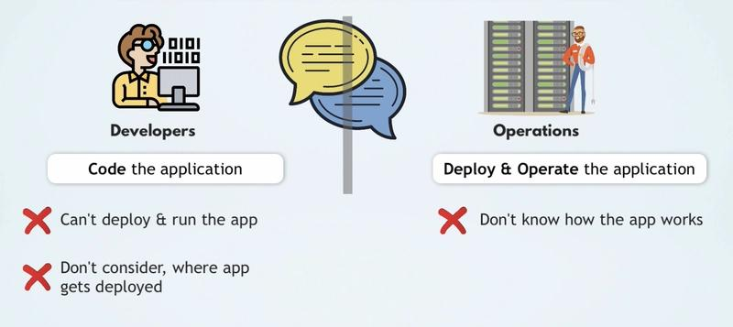
Development Team vs Operations Team
Development Team (Dev)
The development team is responsible for designing and writing the software application. Their main objective is to create new features and improve the functionality of the software.
Responsibilities
Writing program code.
Designing software architecture.
Fixing software bugs.
Implementing customer requirements.
Improving application performance.

Slide 10
Operations Team (Ops)
The operations team is responsible for deploying, managing, and maintaining software after it is developed.
Responsibilities
Deploying applications to servers.
Managing cloud infrastructure.
Monitoring system performance.
Performing backups.
Ensuring application security.
Maintaining high system availability.
DevOps Approach
Instead of working independently, developers and operations engineers work together throughout the project lifecycle. This collaboration helps reduce deployment failures and improves software quality.
Real-Life Example
In a hospital:
Doctors diagnose and treat patients.
Nurses monitor patients and provide ongoing care.
Both roles are equally important. If they fail to communicate, patient care suffers. Similarly, DevOps ensures developers and operations teams work together to deliver reliable software.

Slide 11
Benefits of DevOps
1. Faster Software Delivery
Automation allows software to be developed, tested, and deployed much faster. Organizations can release updates frequently without long delays.
2. Improved Collaboration
Developers, testers, and operations engineers work as one team, improving communication and reducing misunderstandings.
3. Better Software Quality
Automated testing detects bugs early, reducing the chances of software failures after deployment.
4. Increased Reliability
Continuous monitoring helps identify and resolve issues before they affect customers, improving system stability.

Slide 12
Benefits of DevOps
5. Automation
Many repetitive tasks, such as testing, deployment, and infrastructure setup, are automated. This saves time and reduces human errors.
6. Reduced Costs
Early bug detection and automated processes reduce maintenance costs and minimize downtime.
7. Higher Customer Satisfaction
Customers receive new features, bug fixes, and security updates more quickly, leading to a better user experience.

Slide 13
SDLC (Software Development Life Cycle) & DevOps Integration
How Does DevOps Fit into SDLC?
Traditional SDLC follows a sequential process where each phase is completed before moving to the next.
DevOps integrates with every phase of SDLC by introducing:
Automation
Continuous Testing
Continuous Integration (CI)
Continuous Deployment (CD)
Continuous Monitoring
Instead of waiting until the end of the project, DevOps encourages continuous collaboration and feedback throughout the software lifecycle.

Slide 14
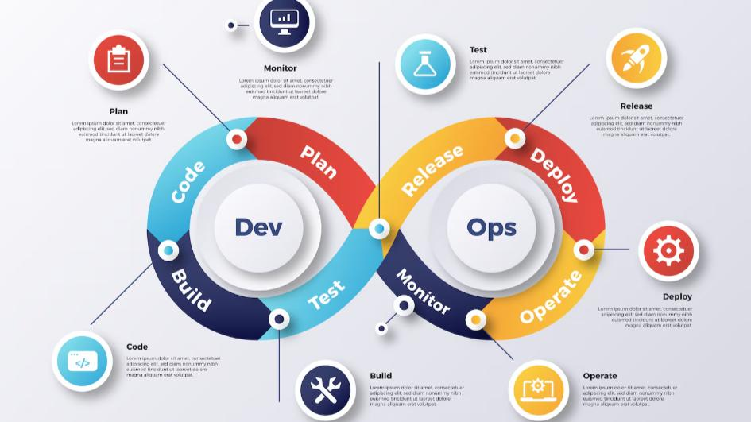
SDLC Without DevOps
Requirement → Design → Development → Testing → Deployment
If a bug is found after deployment, fixing it takes more time and cost.
SDLC With DevOps
Every phase is connected.
Developers continuously:
Write code.
Test automatically.
Deploy frequently.
Monitor applications.
Improve software based on feedback.

Slide 15
Role of the Development Team (Dev)
Who is the Development Team?
The Development team is responsible for creating the software application. Their main goal is to develop new features, improve existing functionality, and fix software bugs. The developer's goal is to create software that meets customer requirements and works correctly.
Responsibilities of Developers
Understand customer requirements.
Design the software architecture.
Write program code.
Develop new features.
Fix software bugs.
Perform unit testing.
Improve application performance.
Maintain code quality.

Slide 16
Role of the Operations Team (Ops)
Who is the Operations Team?
The Operations team is responsible for deploying, running, and maintaining the software after development is completed.
Even if the software is perfectly developed, users cannot access it until the Operations team deploys it to servers. The Operations team's goal is to ensure that the application runs smoothly and is available to users 24×7.
Responsibilities of Operations Team
Deploy applications.
Configure servers.
Manage cloud infrastructure.
Monitor application performance.
Ensure system security.
Perform backups.
Handle server failures.
Maintain high availability.

Slide 17
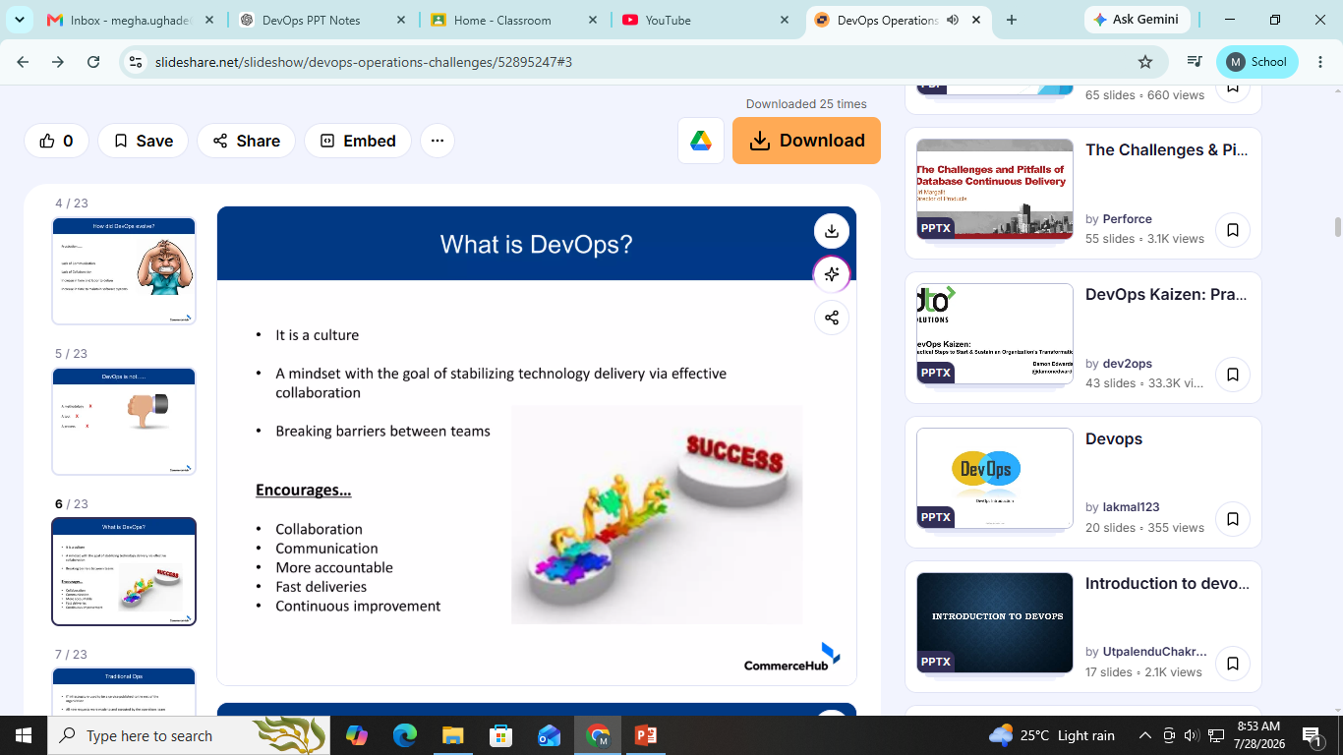
Challenges Between Dev and Ops
Why Did Problems Occur?
Before DevOps, Development and Operations teams had different goals.
Development Team Wants
New features.
Fast coding.
Quick software release.
Operations Team Wants
Stable systems.
Fewer failures.
Secure deployments.
Because their priorities were different, conflicts often occurred.

Slide 18
Common Challenges
1. Poor Communication
Developers and Operations teams communicated only when deployment was required.
Important information was often missed.
2. Slow Deployment
Deployment was mostly manual.
It took hours or even days to release software.
3. Different Priorities
Developers wanted speed.
Operations wanted stability.
Balancing both objectives was difficult.

Slide 19
4. Blame Culture:
If deployment failed: Developers said, "The code works on my computer.“
Operations replied, "The application fails on the production server.“
Instead of solving the issue together, teams blamed each other.
5. Manual Work
Many deployment activities were performed manually.
Manual processes increased the chances of mistakes.

Slide 20
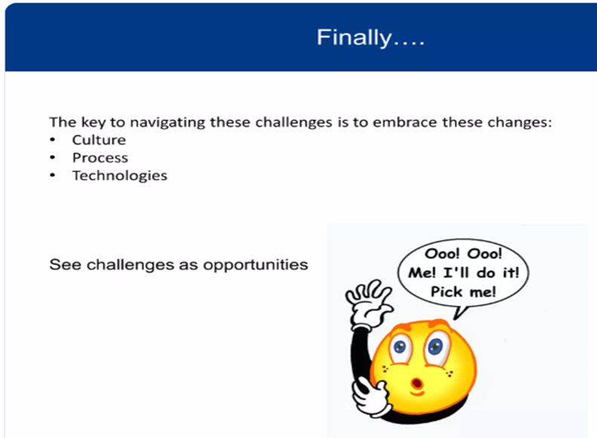
How DevOps Solves These Problems
DevOps Solution
DevOps brings Development and Operations together as one team.
DevOps (Running the App)
After the app is developed:
Developers push new code to Git.
Jenkins automatically builds and tests it.
Docker packages the application.
Kubernetes deploys it to servers.
Monitoring tools check if the app is healthy.
If an issue occurs, DevOps quickly rolls back to the previous version.
This is DevOps.

Slide 21
Traditional SDLC Models (Waterfall & V-Model)
Waterfall Model
Definition:
The Waterfall Model is a linear and sequential software development model where each phase must be completed before moving to the next.
Phases:
Requirement Analysis
System Design
Implementation (Coding)
Testing
Deployment
Maintenance
Characteristics:
Sequential process (one phase after another)
No going back to previous phases easily
Best when requirements are fixed and clear
Documentation is extensive

Slide 22
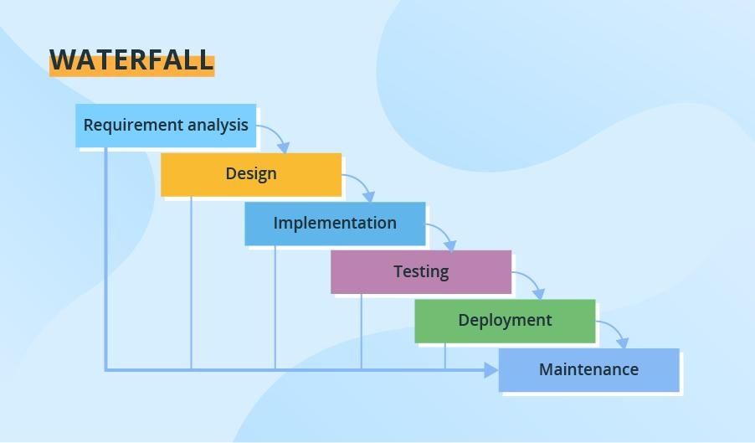
Advantages:
Simple and easy to understand
Easy to manage
Well-defined stages
Disadvantages:
Difficult to make changes later
Customer sees the product only at the end
Bugs may be found late

Slide 23
V-Model (Verification and Validation Model)
Definition:
The V-Model is an extension of the Waterfall model where each development phase has a corresponding testing phase.
Development Phase → Testing Phase
Requirements → Acceptance Testing
System Design → System Testing
Architecture Design → Integration Testing
Module Design → Unit Testing
Coding → (Center of the V)

Slide 24
Characteristics:
Testing is planned from the beginning
Verification and validation happen at every stage
Suitable for projects requiring high quality and reliability
Advantages:
Early test planning
Better software quality
Easier defect detection
Disadvantages:
Rigid model
Changes are difficult
Not suitable when requirements change frequently

Slide 25
Waterfall vs V-Model
Development Phase (Verification) | Corresponding Testing Phase (Validation) | Explanation
Requirements Analysis | Acceptance Testing (UAT) | Checks whether the final software meets all customer requirements.
System Design | System Testing | Tests the complete system to ensure all functionalities work correctly.
Architecture (High-Level) Design | Integration Testing | Verifies that different modules/components work together properly.
Module (Low-Level) Design | Unit Testing | Tests each individual module or function separately.
Coding (Implementation) | Center of the V | Developers write the code. After coding, testing starts from Unit Testing and moves upward.

Slide 26
What is DevOps Culture?
Introduction
DevOps culture is a way of working where Development (Dev), Operations (Ops), Testing (QA), and Security teams work together instead of working separately. The main goal is to deliver software faster with better quality.
DevOps is not only about using tools like Git, Docker, Jenkins, or Kubernetes. The most important part of DevOps is Culture.
Culture means the way people work, communicate, and solve problems together in an organization.
Before DevOps, the Development, Testing, and Operations teams worked independently. Each team focused only on its own tasks. This often caused communication gaps, delays, and software failures.
DevOps changes this by creating a culture where everyone works together with a common goal:
Deliver high-quality software quickly and reliably.

Slide 27
Cultural & Organizational Aspects of DevOps
1. Collaboration (Working Together)
What is Collaboration?
Collaboration means that developers, testers (QA), operations engineers, security teams, and business stakeholders work together as one team throughout the Software Development Life Cycle (SDLC). Instead of working in separate departments (called silos), everyone shares information, solves problems together, and works toward a common goal of delivering quality software quickly. DevOps emphasizes breaking down these traditional silos through teamwork and shared workflows.

Slide 28
2. Shared Responsibility (You Build It, You Run It)
What is Shared Responsibility?
In traditional software development, developers only write code, and the operations team manages the software after deployment.
In DevOps, everyone shares responsibility for the application's success or failure. Developers not only build the software but also help monitor, maintain, and fix issues after deployment. This is known as "You Build It, You Run It.“
3. Communication
What is Communication?
Communication means that all team members regularly exchange information about development, testing, deployment, production issues, and customer feedback. DevOps encourages open, transparent communication using meetings, dashboards, chat tools, and documentation.

Slide 29
4. Continuous Learning
What is Continuous Learning?
Continuous learning means that individuals and teams constantly improve their skills, learn from failures, adopt new technologies, and share knowledge with each other. DevOps promotes experimentation, fast feedback, and learning from both successes and mistakes.
5. Trust & Transparency
What is Trust & Transparency?
Trust means team members believe in each other's skills and intentions. Transparency means everyone can see project progress, deployment status, issues, and performance metrics openly. There is no hiding of problems or blaming individuals. DevOps promotes openness and psychological safety so teams can improve together.
6. Customer Focus
What is Customer Focus?
Customer focus means all development decisions are made to provide maximum value and satisfaction to users. Teams continuously collect customer feedback and improve the software based on user needs rather than assumptions.

Slide 30
What is the CAMS Model?
The CAMS Model is a framework that defines the four core principles of DevOps. It was introduced by John Willis and Damon Edwards to help organizations successfully adopt DevOps practices. CAMS stands for:
C – Culture
A – Automation
M – Measurement
S – Sharing
The model emphasizes that DevOps is not only about tools but also about people, processes, collaboration, and continuous improvement. It provides a foundation for building a fast, reliable, and customer-focused software delivery process.

Slide 31
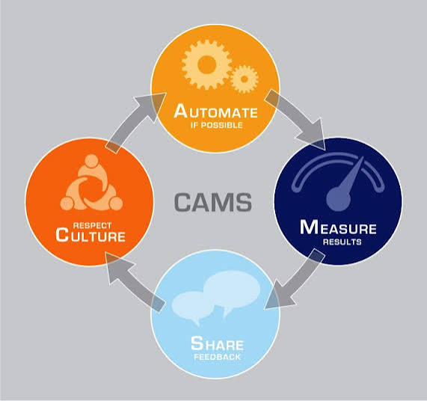
CAMS Model

Slide 32
1. C – Culture
What is Culture?
Culture is the most important pillar of DevOps. It focuses on creating an environment where developers, testers, operations, and security teams work together with shared goals, trust, and responsibility instead of working in isolated departments (silos). Organizations adopting DevOps prioritize collaboration, openness, continuous learning, and customer value.
Objectives
Break down team silos.
Encourage teamwork.
Build trust and transparency.
Promote continuous learning.
Focus on customer satisfaction.
Benefits
Faster problem solving
Better software quality
Improved productivity
Higher employee satisfaction

Slide 33
2. A – Automation
What is Automation?
Automation means using software tools to perform repetitive tasks automatically instead of manually. DevOps automates coding, testing, building, deployment, infrastructure provisioning, monitoring, and configuration management to reduce errors and improve speed. Automation increases consistency and frees teams to focus on innovation.
Objectives
Reduce manual work.
Minimize human errors.
Speed up software delivery.
Increase consistency.
Improve reliability.

Slide 34
Tasks That Can Be Automated
Code compilation
Automated testing
Build creation
Deployment
Infrastructure provisioning
Server configuration
Monitoring
Backup
Common Automation Tools
Git , Jenkins , Docker , Kubernetes , Ansible ,Terraform
Benefits
Faster releases
Fewer deployment failures
Consistent environments
Better productivity
Reduced operational cost

Slide 35
3. M – Measurement
What is Measurement?
Measurement means collecting and analyzing data to evaluate how well the DevOps process is performing. Organizations measure important metrics (KPIs) to identify bottlenecks, improve performance, and make data-driven decisions. A common DevOps principle is: "If you can't measure it, you can't improve it."
Objectives
Track software performance.
Measure team productivity.
Improve delivery speed.
Detect problems early.
Support continuous improvement.

Slide 36
Measurement Tools
Prometheus
Grafana
ELK Stack
Splunk
Datadog
Benefits
Better decision making
Faster issue detection
Higher software quality
Improved customer experience
Continuous optimization

Slide 37
4. S – Sharing
What is Sharing?
Sharing means openly exchanging knowledge, experiences, feedback, tools, documentation, and lessons learned among all team members. DevOps encourages a learning culture where successes and failures are shared to improve future work rather than assigning blame.
Objectives
Improve collaboration.
Spread knowledge across teams.
Learn from mistakes.
Avoid repeating problems.
Encourage innovation.

Slide 38
What Teams Share
Documentation
Best practices
Code reviews
Deployment procedures
Lessons learned
Incident reports
Performance dashboards
Knowledge Sharing Methods
Daily stand-up meetings
Team retrospectives
Wiki pages
Documentation
Workshops
Internal training sessions

Slide 39
Real-Life Example of CAMS
Company: Amazon
Culture: Developers, testers, and operations teams work together.
Automation: Jenkins automatically builds and tests every code change.
Measurement: CloudWatch monitors application performance, server health, and response time.
Sharing: Teams discuss deployment results, share lessons learned, and continuously improve future releases.

Slide 40
Advantages of the CAMS Model
Encourages teamwork and collaboration.
Reduces manual effort through automation.
Enables data-driven decision making using metrics.
Promotes continuous learning and knowledge sharing.
Improves software quality and reliability.
Speeds up software delivery.
Increases customer satisfaction.
Supports continuous improvement and innovation.

Slide 41
Thank You!
Unit –I End

